Slide 1

Progress Report
12/7/11

Slide 2
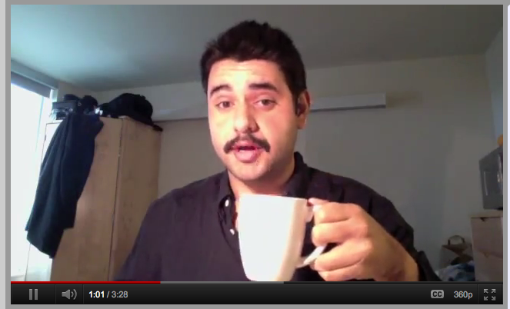
Remember this?

Slide 3
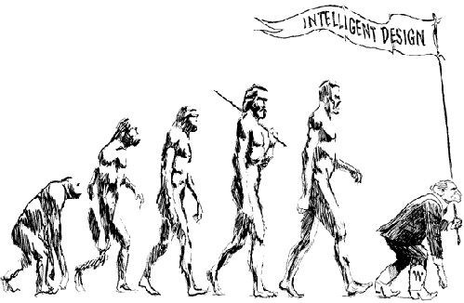
What’s happened since?
Receipted has
evolved…

Slide 4
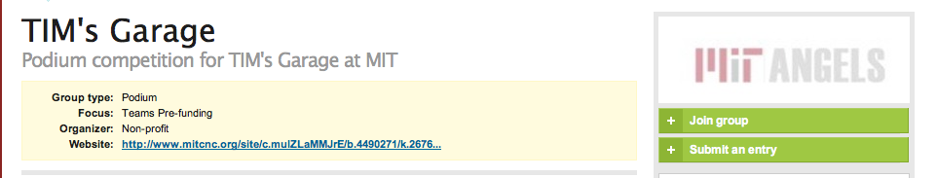
First, I got some great news…
The video worked!
I got into a fledging accelerator!

Slide 5

Sweet!

Slide 6
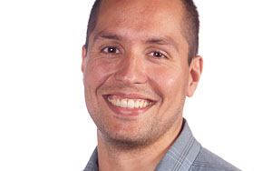
So I got to work..
First, I got set up with a mentor.
He’s really smart!

Slide 7
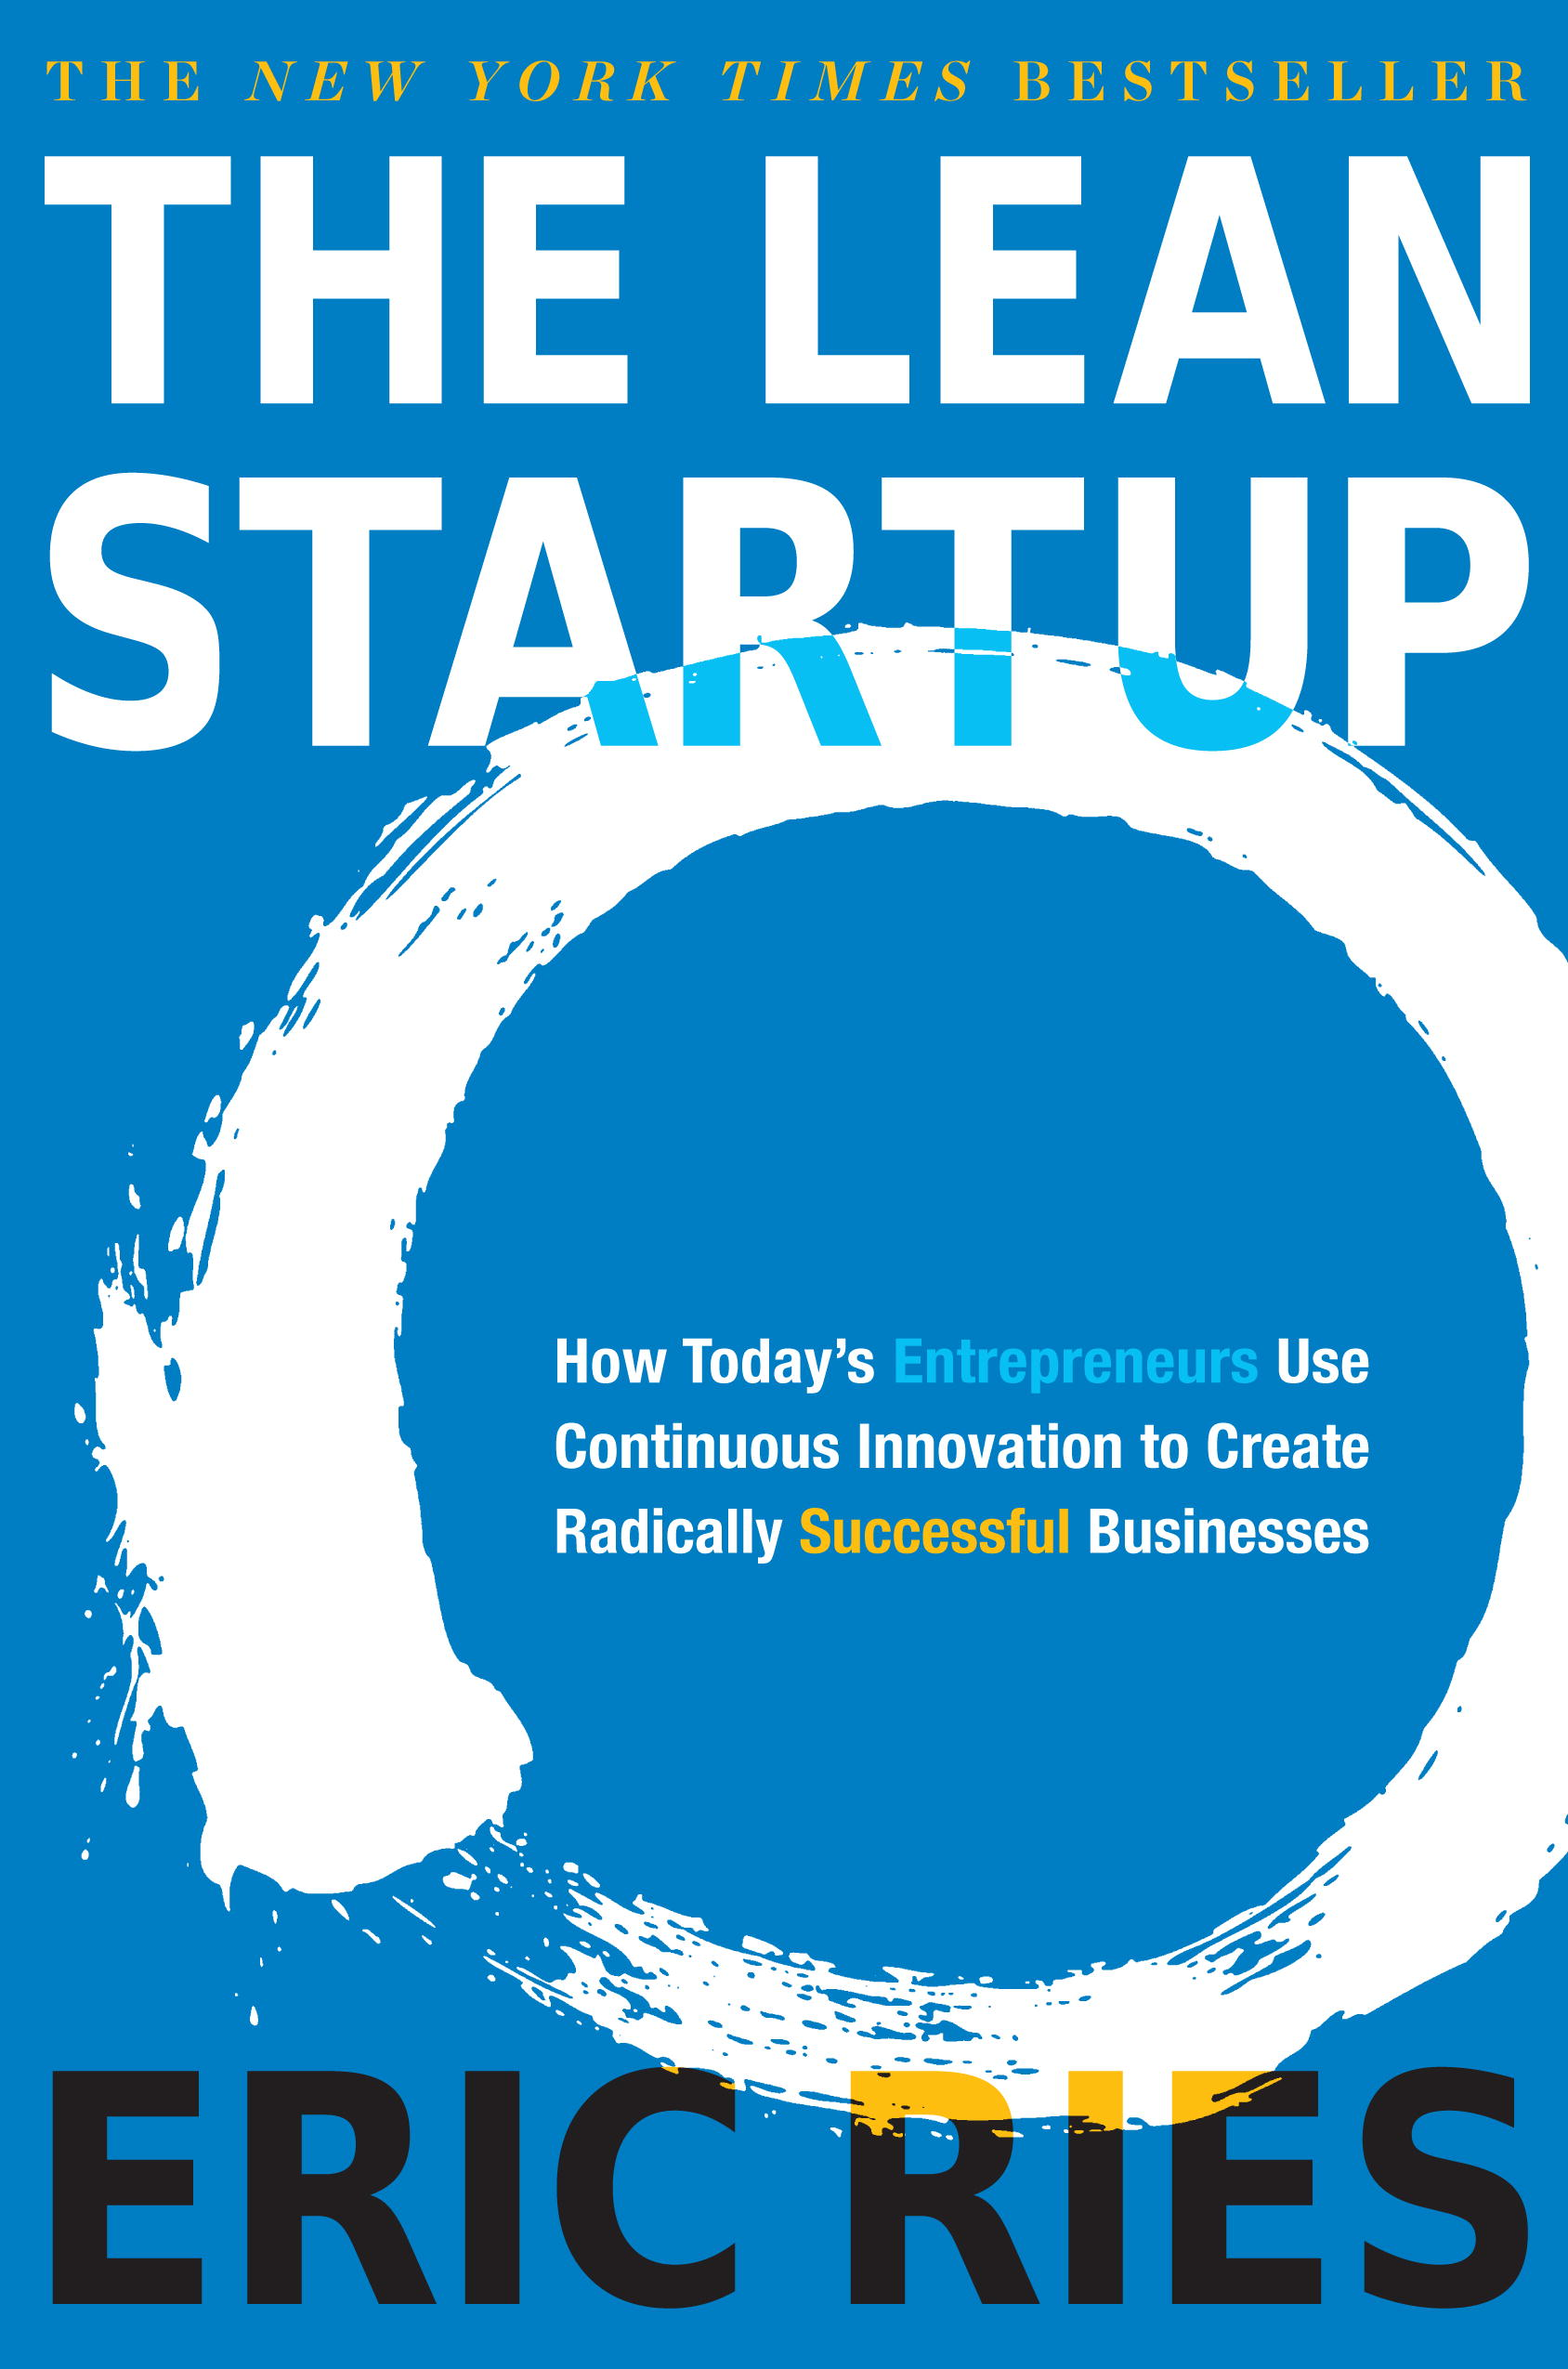

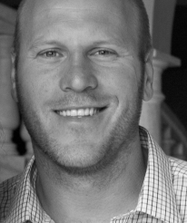
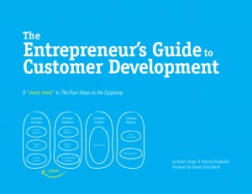
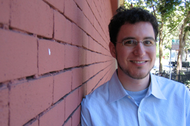
And I got some homework…
By these guys…
They’re really smart too!

Slide 8
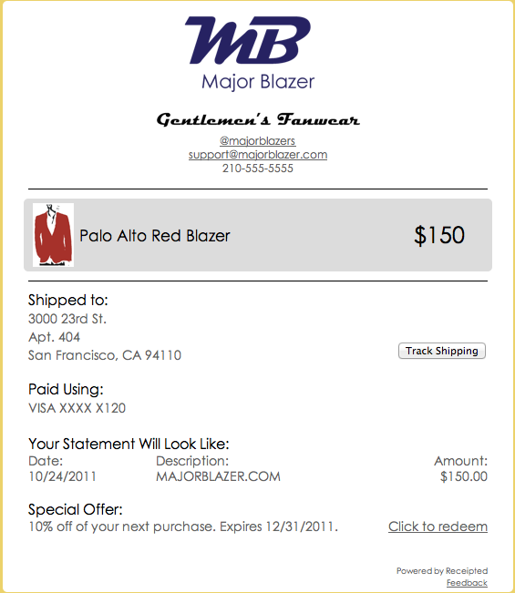
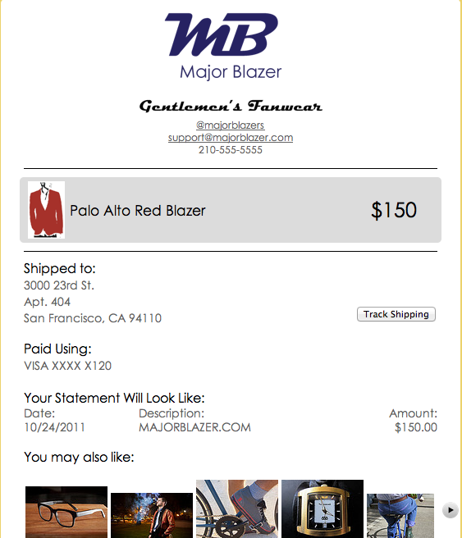
And I did some hacking…
I’m pretty bad at it
But it doesn’t matter!

Slide 9
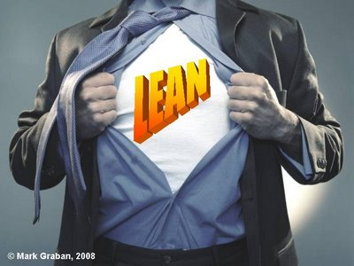
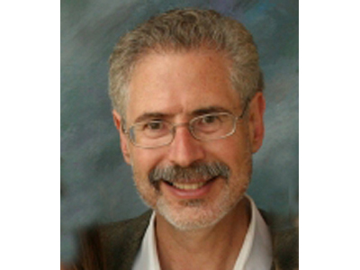
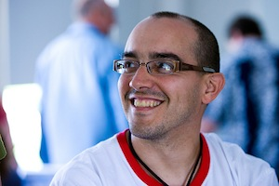
But more importantly…
I’ve subscribed to the lean startup lifestyle
Here are my idols:

Slide 10
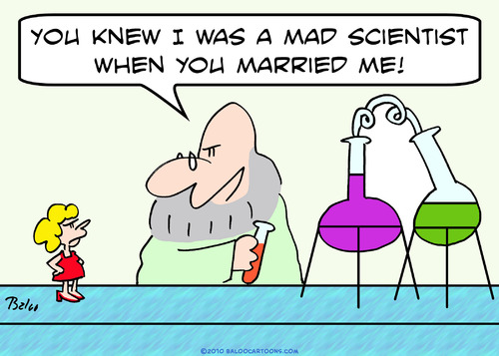
But why?
Why not just dive head in?
Because there is science behind it!

Slide 11
A sample of hypotheses
1. “Stores are missing out on receipts”
2. “Stores want better designed receipts and customers hate them”
3. “Stores want better receipts”
4. “Stores want better receipts with upsell potential”
5. “I am interested in upsell opportunities”
a. “I am actively upselling”

Slide 12
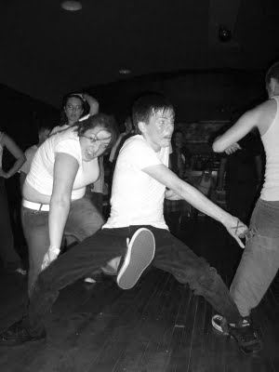
Then I got some bad news…
“We are no longer running our accelerator”

Slide 13
But the very same day…
“Hey, you wanna work in my office in January?”

Slide 14

Man, what they say is true…
Entrepreneurship really is a roller coaster

Slide 15
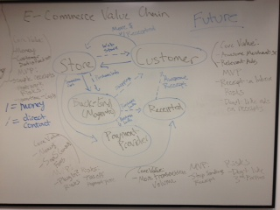
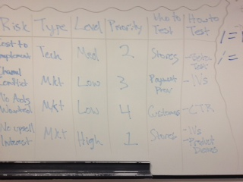
So I continue to work…
SXSW Accelerator
Venture Mentoring Services
MIT 100K Accelerator
And make pretty charts like these…

Slide 16
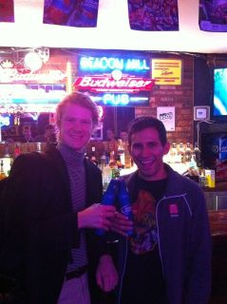
What I need more than anything else…
Is for you to help me…
By…
…connecting me with any and all of your e-commerce connections.
And to help entice you I’m offering a referral fee…
…of one beer at BHP.

Slide 17
Thanks!
betoiii@gmail.com
@betoiii

